Slide 1

Chess: Battle Royale Juego Studios
Presentation to Dave Bruce and Game Programming batch of 2023 @St. Lawrence College, Cornwall, ON, CA
By Bishal Sapkota, Hayley Farrows, Kevin De La Bastide, Parvesh Kumar, Kether Fontaine-MacKinnon, David Jaramillo Castro .
03/12/2023

Slide 2

Market Overview
Focused Market: Online multiplayer gaming targeting console and PC players, embracing both casual and hardcore gamers.
The market for games is huge, especially when it comes to online multiplayer. Our emphasis on fusing the well-liked battle royale style with chess presents a novel idea. These days, players are looking for captivating games that blend competitive multiplayer dynamics with strategic complexity.
Innovative gameplay ideas that appeal to both casual and serious players are in high demand considering the growth of esports and online competitive gaming.

Slide 3

Market Opportunity
The online multiplayer game market is expected to grow by 10% annually, contributing to the overall steady growth of the gaming industry. Technological developments, easier access to the internet, and changing consumer preferences for immersive and interactive gaming experiences are the main drivers of this rise.
This industry is expanding due to the rise in online gaming platforms, advancements in gaming technologies, and an ongoing search for novel gameplay ideas.

Slide 4

Our Game
Chess: Battle Royale
In a world where chess meets battlegrounds, 64 players clash in a thrilling online arena, each commanding their animal-themed chess army. Diverse chapters and epic boss battles unfold as players navigate a rich narrative, facing strategic chess challenges and engaging in fierce conflicts to determine the fate of kingdoms.
Online Chess Battle Royale: A fusion of classic chess strategy with intense multiplayer action for up to 64 players.
Thematic Elements: Customize chess pieces with various themes earned through challenges, offering diverse visual experiences.
Story-focused Gameplay: Take part in a deep narrative that spans several chapters and boss fights, enhancing the classic chess game experience.

Slide 5
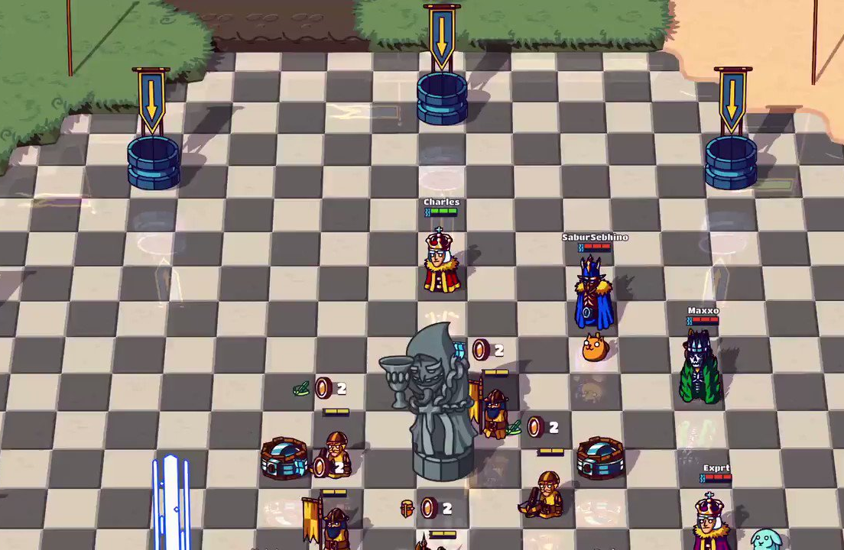
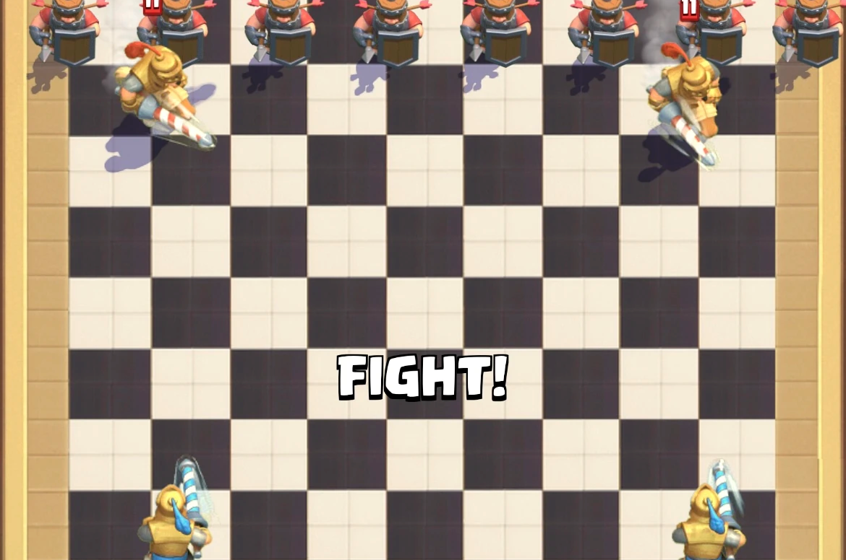
Visuals
Our game have visuals like these, as we are using 2D motion tracking, this are the top and front view of our game.

Slide 6
Think of it as XXXXX meets YYYY
Envision a fusion of traditional chess tactics and the thrilling experience of a battle royale, providing a rich and imaginative world that captivates both single and multiplayer chess players.

Slide 7

Why We're Different
An advantage over competitors:
Play: Provides a unique blend of traditional chess rules with intense online multiplayer action.
Art & Audio: The game's overall experience is improved by its visually appealing cartoony aesthetics and immersive sound design.
Delivery & Story: Presents an engrossing chess game with a compelling story and thematic components woven throughout. This completes the gaming experience.

Slide 8

Where We're Going
Among the items in our strategic plan are:
Market Fit: A thorough examination of the market that highlights the positioning of our game and its expected growth in the first three years.
Launch Strategy: Outlining the date of our intended launch, our marketing initiatives, and our user acquisition plans.
Sales Projections: Based on anticipated user engagement and market research, we will present our revenue projections and growth trajectory.

Slide 9

Our Experience
Background of the Team:
The team members are currently enrolled in St. Lawrence College's Game Programming program, which allows them to bring a combination of theoretical knowledge and real-world experience to the project.
Past joint game development projects that concentrated on different facets like coding, design, art, and quality control.

Slide 10
Current Status
We intend to launch in beta form initially, having moved past the conceptual stage.

Slide 11

What We Offer
Investment Requirement: Offering a 20 percent share in the company, we are looking to raise $200,000 for marketing, server infrastructure, and additional development.
Partnership Opportunities: In addition to money, investors can offer insightful industry connections, strategic advice, and mentorship that will help with expansion and market penetration.

Slide 12

Thank You!!!

